Slide 1
Evento-GNDEC Event guide
Submitted By:
Nihar Kanwar
1243683

Slide 2
CONTENTS
Introduction
Existing system
Proposed system
Objective
Software specification
Hardware specification
Flowchart
Screenshots
Conclusion
Future Scope

Slide 3
INTRODUCTION
Notifies students about events held by various societies of college.
Event administrator can create events and students can join events.
Admin can modify/delete events once created.
Students are notified about scheduling of various events through email service.
Students can suggest events to administrators.

Slide 4
EXISTING SYSTEM
Manual system of event notification
Does not allow users to easily edit data
Students need to reach notice boards frequently
Confusion regarding maintaining list of participating students

Slide 5
PROPOSED SYSTEM
Eliminates wastage of time and energy
No need to maintain physical list
Notification about changes in existing event.
Automatically Updated Dashboard
Ease of use

Slide 6
OBJECTIVE
Faster dissemination of notices regarding various events.
Easy way to broadcast your message.
Make event handling efficient and interactive
Good way to maintain list of participating students.
Eliminating the need of class announcements.
Close interaction between users and administrators.
Suggesting events to various societies’ administrators.
User friendly interface

Slide 7
SOFTWARE SPECIFICATION
Programming Language: Java
Web Languages: XML
Database: SQLite
IDE: Android Studio
Operating System: Android

Slide 8
HARDWARE SPECIFICATION
Processor: 500 MHz
RAM: Minimum 512MB
Storage:50 Mb

Slide 9
FLOWCHART
­
Main/Start Page
Login
User
Admin
Event dashboard
Event dashboard
Join event
Suggest event
Edit profile
Create event
Show joined users
Modify event
Delete event

Slide 10
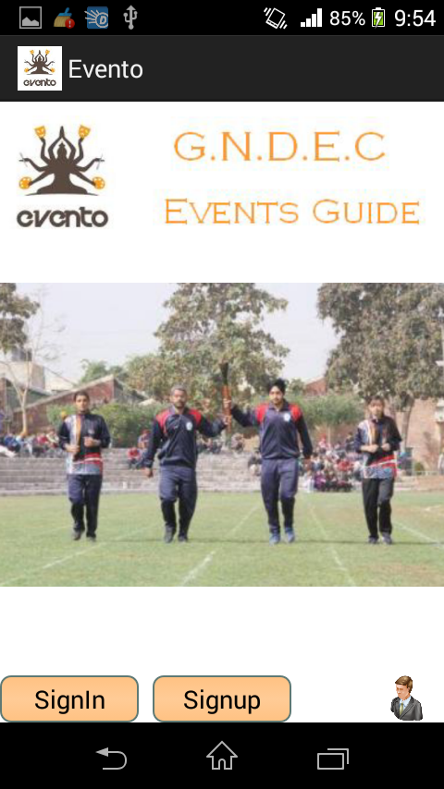
SCREENSHOTS
Home Page

Slide 11
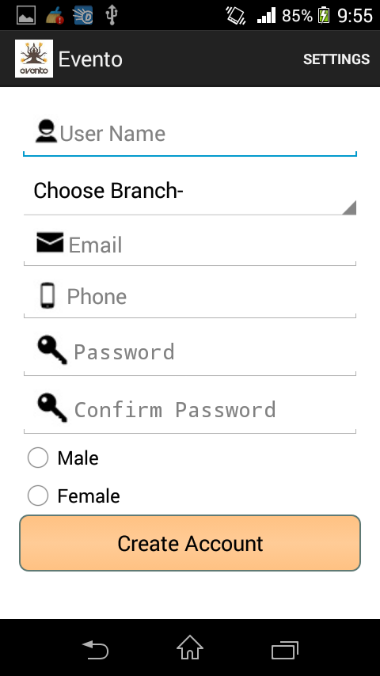
Sign Up Page

Slide 12
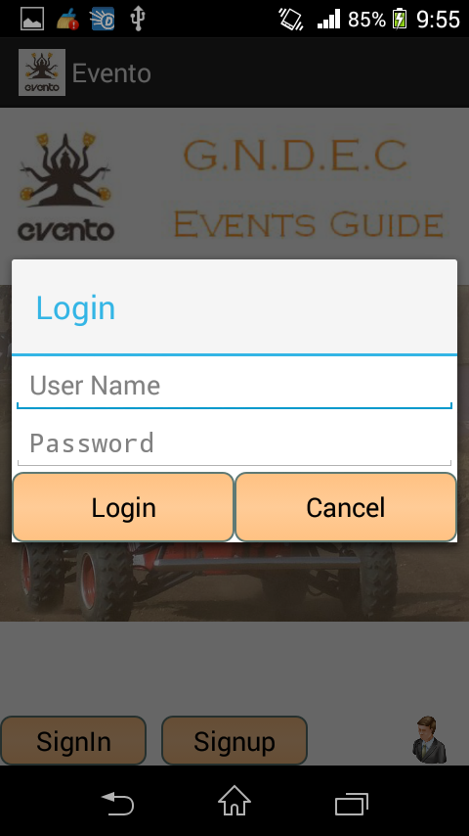
Login Dialog Box

Slide 13
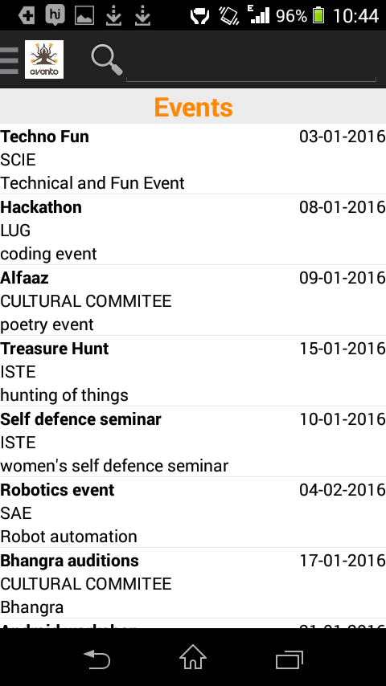
Event dashboard page

Slide 14
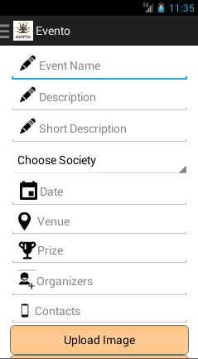
Create event page

Slide 15
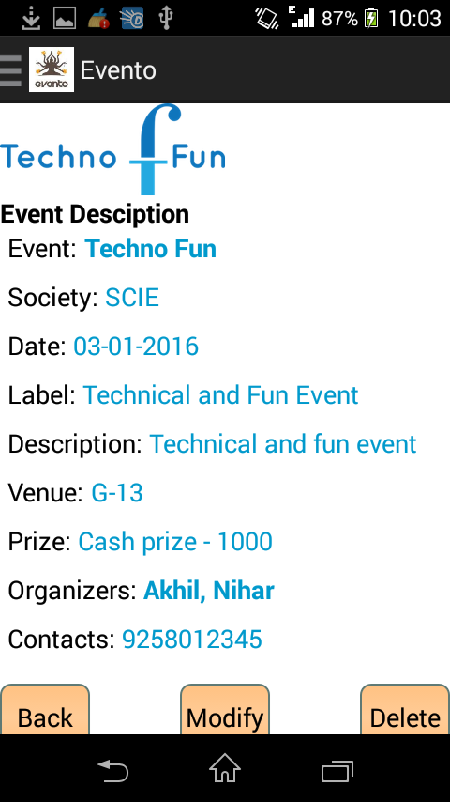
Event description page for admin

Slide 16
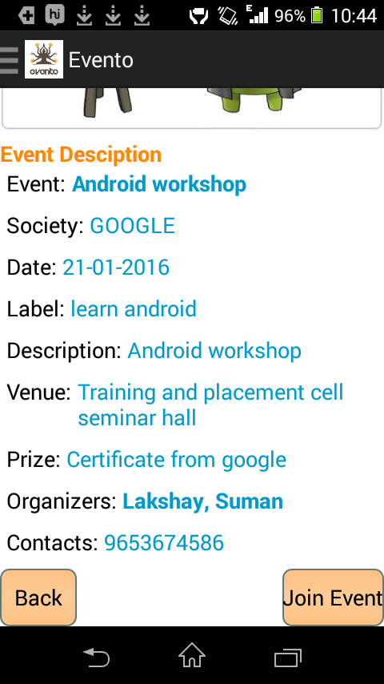
Event description page for user

Slide 17
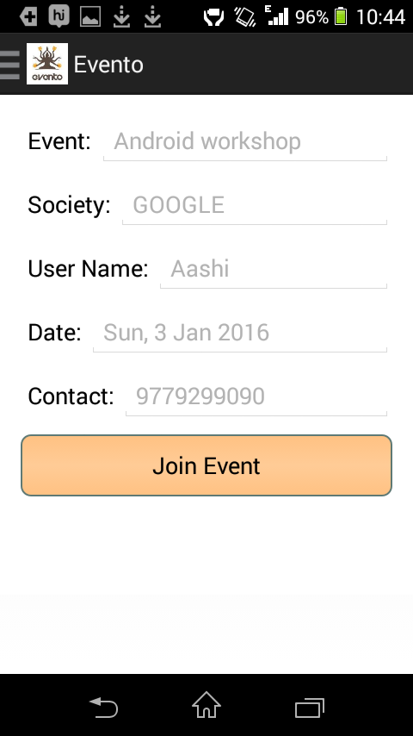
Join event page

Slide 18
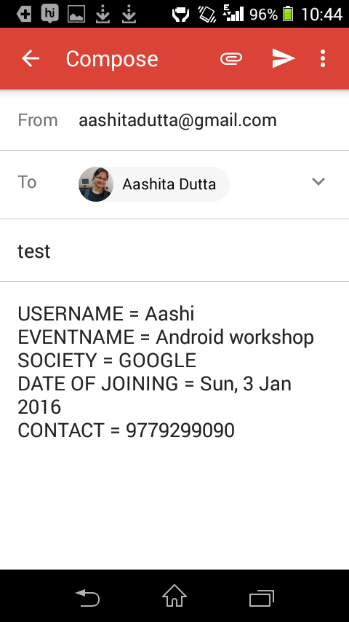
Send email notification

Slide 19
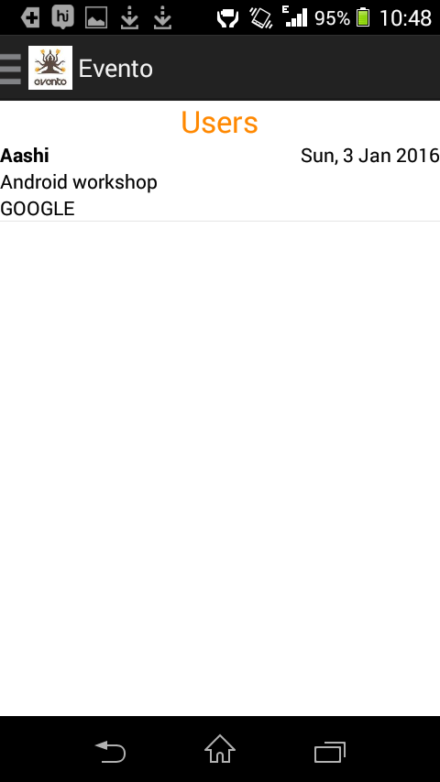
Show users page

Slide 20
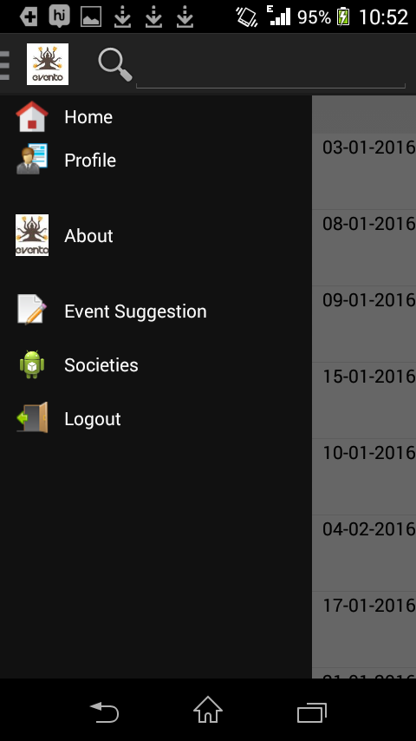
Navigation bar

Slide 21
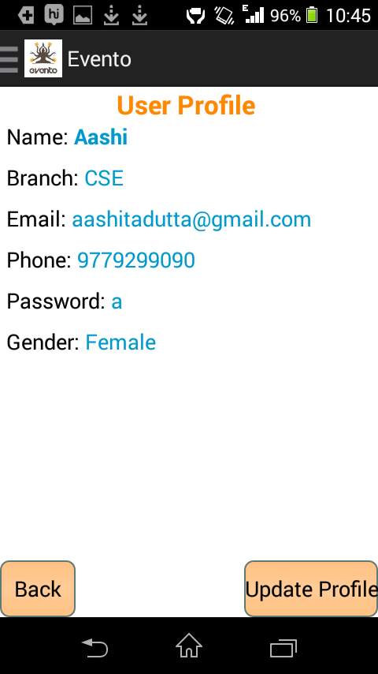
User profile page

Slide 22
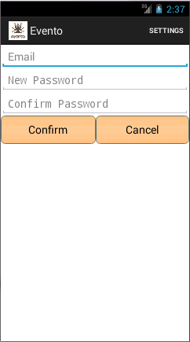
Reset password page

Slide 23
CONCLUSION
Evento application overcomes all the limitations and drawbacks of the existing system.
The Evento Application is user-friendly and user interface is easy to use.
There is no longer any need to maintain physical listing of students for events.
It bridges the gap between Student and Organizer.

Slide 24
FUTURE SCOPE
Events can be categorized in different categories like technical, techno-fun, fun, or cultural etc.
The attachments can be further improved to include PDF files or Doc files.
Feedback on the notices can also be taken.
Further implementation of chat facility can be done in this app

Slide 25
Thank you!

